Slide 1
DATA ANALYSIS USING SQL
WORLD POPULATION
AKASH V

Slide 2
Data Cleaning
Showing all records in the table
Select Rank ,
Country ,
Capital,
Continent,
2022 Population,
2020 Population,
2015 Population,
2010 Population,
2000 Population,
1990 Population,
1980 Population,
1970 Population,
Population Percentage FROM world population

Slide 3
Removing and Renaming
select * from world_population$;
alter table world_population$
drop column [Area (km²)],[CCA3];
exec sp_rename '[dbo].[world_population$].[World Population Percentage]','percentage'
exec sp_rename '[dbo].[world_population$].[Density (per kmÂ²)]','Density'

Slide 4
Updating World Population
update world_population$
set [difference_2022] = [2022 Population]-[2020 Population],
[difference_2020] = [2020 Population]-[2015 Population],
[difference_2015] = [2015 Population]-[2010 Population],
[difference_2010] = [2010 Population]-[2000 Population],
[difference_2000] = [2000 Population]-[1990 Population],
[difference_1990] = [1990 Population]-[1980 Population],
[difference_1980] = [1980 Population]-[1970 Population];
alter table [dbo].[world_population$]
add percentages int;
update world_population$
set [percentages]=(([2022 Population]-[1970 Population])/[1970 Population]*100)

Slide 5
Max Population
SELECT MAX([2022 Population]) AS [Population], '2022' AS [YEAR]
FROM world_population$
UNION ALL
SELECT MAX([2020 Population]) AS [Population], '2020' AS [YEAR]
FROM world_population$
UNION ALL
SELECT MAX([2015 Population]) AS [Population], '2015' AS [YEAR]
FROM world_population$
UNION ALL
SELECT MAX([2010 Population]) AS [Population], '2010' AS [YEAR]
FROM world_population$
UNION ALL
SELECT MAX([2000 Population]) AS [Population], '2000' AS [YEAR]
FROM world_population$
UNION ALL

Slide 6
Top 5 growth rate based on country
select top 5 [Growth Rate],Country from [dbo].[world_population$]
order by [Growth Rate] desc;

Slide 7
Top 5 percentage based on continent
select distinct top 5 percentage,continent from [dbo].[world_population$]
order by percentage;

Slide 8
Top 5 Asia continent based on 2022 population
select distinct top 5 Continent,[2022 Population] ,country from world_population$
where Continent='asia'
order by [2022 Population] desc

Slide 9
Density Based on continent
select distinct top 5 density,continent from world_population$
order by Density;

Slide 10
SQL to Excel
Export cleaned data from SQL to Microsoft Excel
Data Visualization Using Microsoft Excel

Slide 11
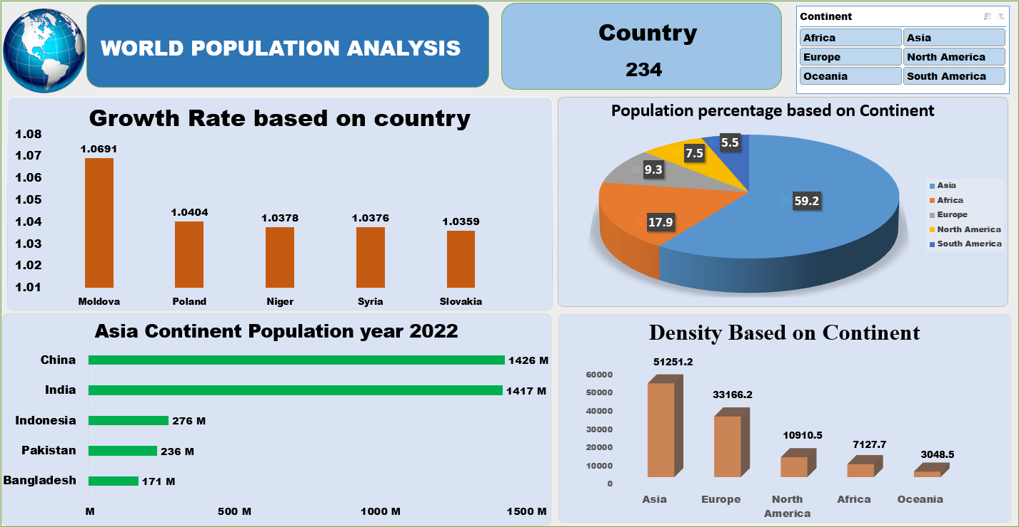

Slide 12
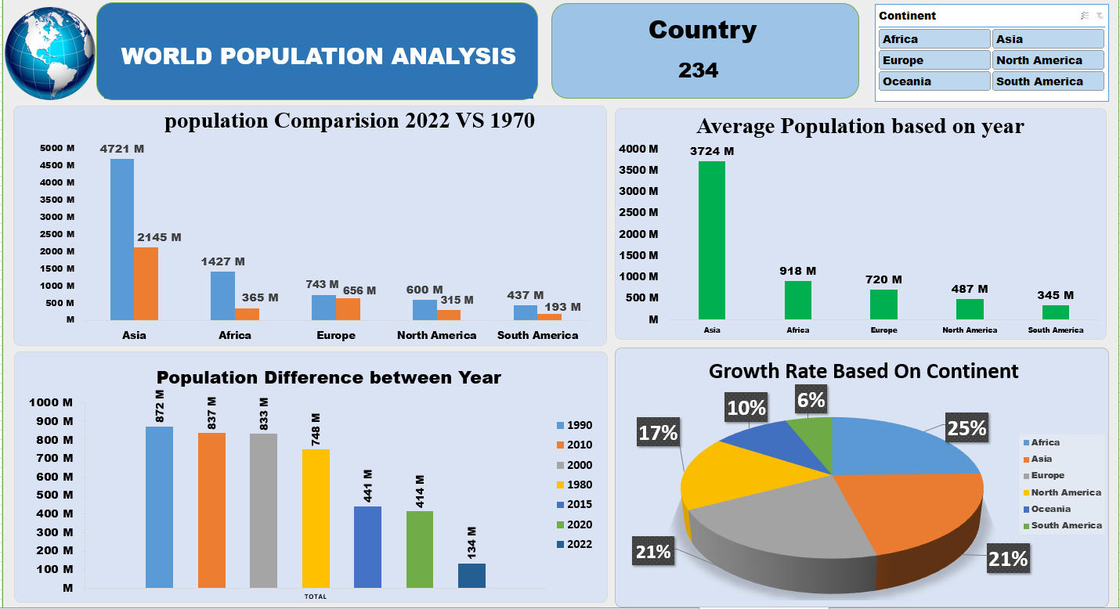

Slide 13
Insights
Asia leads in all metrics with highest population every year
China leads with highest population with in Asian continent
Asia continent has highst population of 59.2 % percent followed by Africa
Population comparison between year 2022 and 1970 was done
Africa has a highest growth rate of 25%
Highest population difference was between year 1990 and 2000

Slide 14

AKASH V

